Slide 1
Chapter 2
Data
Representation
Program
Computer HW
(Von Neumann Model)
Input Data
Output Data
Data Type

Slide 2
自我介绍
SMH
姓名：孙铭会 博士 博士后
单位：吉林大学计算机科学与技术学院
QQ：42600225
主讲本科课程：计算机导论，人机交互技术，RFID实验，微机原理实验，数据库实验等
主讲研究生课程：面向对象数据库，计算机控制技术等

Slide 3
与大家交集：大学生创新训练项目，开放性大学生创新实验，毕业设计，研究生等
以及各项大赛：比如ICAN大赛，机器人大赛，数学建模大赛，物联网大赛

Slide 4
OBJECTIVES
After reading this chapter, the reader should
be able to:
Define data types.
Visualize how data are stored inside a computer.
Understand the differences between text, numbers,
images,video, and audio.

Slide 5
Contents
2.1 Data Types
2.2 Data inside the Computer
2.3 Representing Data

Slide 6
2.1
DATA TYPES

Slide 7
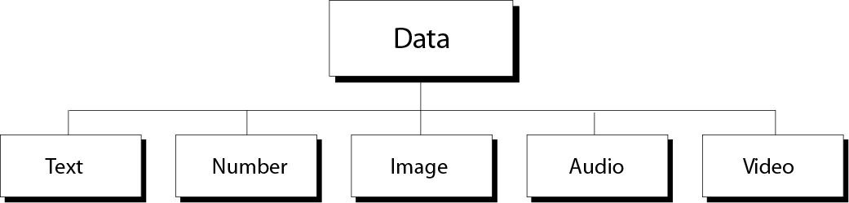
2.1 Data Types
Different types of data
Figure 2-1
Engineering Program: number.
Word processing program: text.
Image processing program: images.

Slide 8

Note:
The computer industry uses the term
“multimedia” to define information that contains numbers, text, images, audio, and video.

Slide 9
2.2
DATA INSIDE
THE COMPUTER

Slide 10
2.2 Data inside the computer
？How do you handle all these data types?
? Do you have different computers process different types of data?
All data types from outside a computer are transformed into a uniform representation when stored in a computer and then transformed back when leaving the computer.
This universal format is called a
bit pattern(位模式).

Slide 11
2.2 Data inside the computer
A bit(binary digit) is the smallest unit of data that can be stored in a computer:it is either 0 or 1.
A single bit can not possibly solve the data representation problem.
To present different types of data, you use a bit pattern, a sequence, or as it is sometimes called, a string of bits.
bit---bit pattern----byte

Slide 12
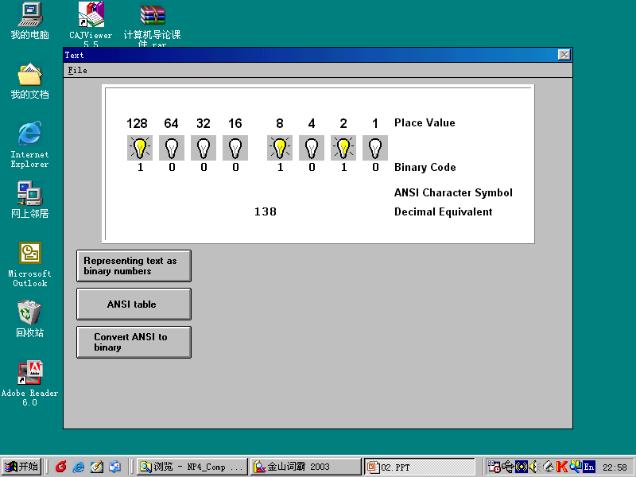
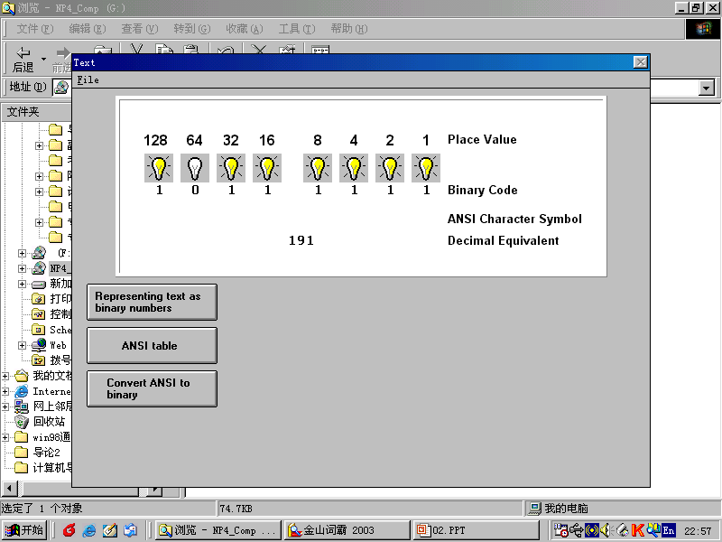
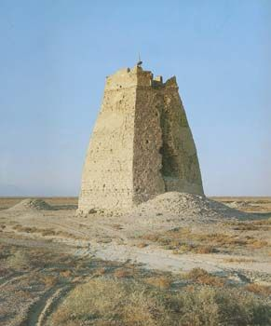
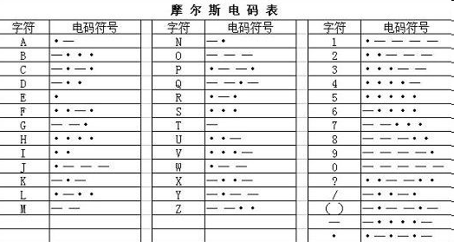
Bit pattern
Figure 2-2
Beacon Tower
Morse Code

Slide 13
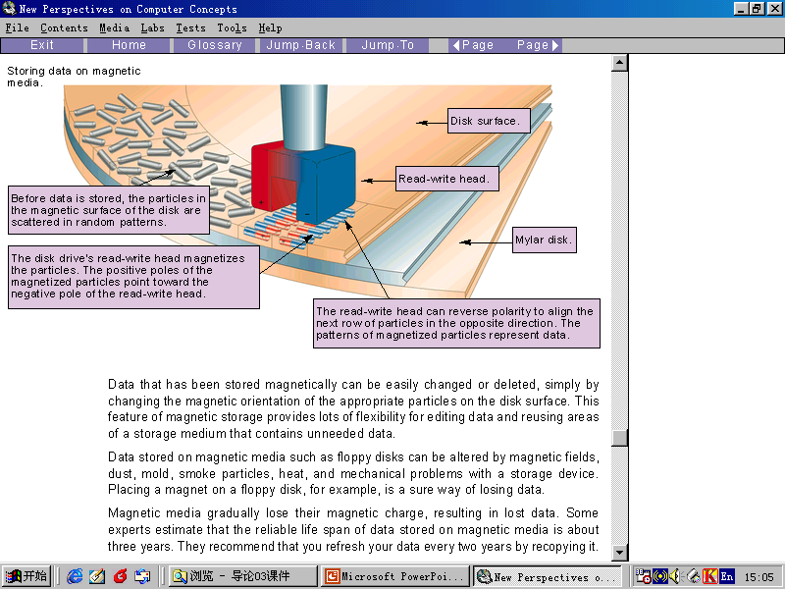
2.2 Data inside the computer

Slide 14
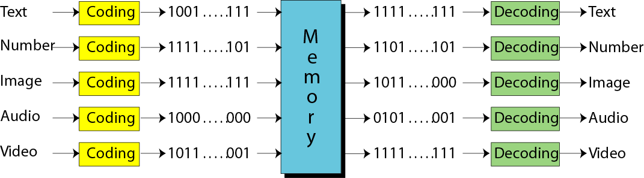
?How does computer memory know what type of data a stored bit pattern represents?
Figure 2-3
Data are coded when they enter a computer and decoded when they are presented to the user.

Slide 15
Thinking computer as
Programmable Data Processor Model
Program
Input Data
Computer HW
(Von Neumann Model)
Output Data
Data Type
Program
Storing different types of data as
universal format ---Bit Pattern
Input Data
Output Data
bit pattern

Slide 16
2.2 Data inside the computer
A bit pattern of length 8 is called a byte.
1K=2¹⁰=1024 byte，
1M=1024K=2¹⁰2¹⁰ byte
1G=1024M=2¹⁰2¹⁰2¹⁰ byte

Slide 17
2.3
REPRESENTING
DATA

Slide 18

2.3 Representing Data---Text
Representing symbols using bit patterns
Figure 2-4
You can represent each symbol with a bit pattern.

Slide 19
Question
How many bits are needed in a bit pattern to represent a symbol in a language?
It depends on how many symbols are in the set.

Slide 20
2.3 Representing Data---Text
Logarithmic:
If you are need two symbols, the length is 1 bit(log₂2=1). If you are need four symbols, the length is 2 bit(log₂4=2) .
A bit pattern of 2 bits:
00 01 10 11
A bit pattern of 3 bits:
000 001 010 011 100 101 111

Slide 21
Table 2.1 Number of symbols and bit pattern length
Number of Symbols
---------------------
2
4
8
16
…
128
256
…
65,536
Bit Pattern Length
---------------------
1
2
3
4
…
7
8
…
16

Slide 22
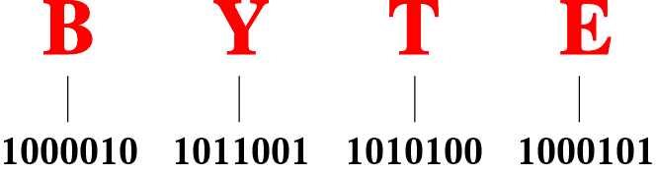
Figure 2-5
Representation of the word
“BYTE” in ASCII code
Code
Different sets of bit patterns have been designed to represent text symbols.Each set is called a code, and the process of representing symbols is called coding.

Slide 23
2.3 Representing Data---Text
The following highlights some features of ASCII code:
It uses a 7-bit pattern ranging from 0000000 to 1111111.
There are 31 control(nonprintable) characters.
The numeric character(0 to 9) are coded before letters.
The uppercase letters(A…Z) come before the lowercase letters(a…z).

Slide 24
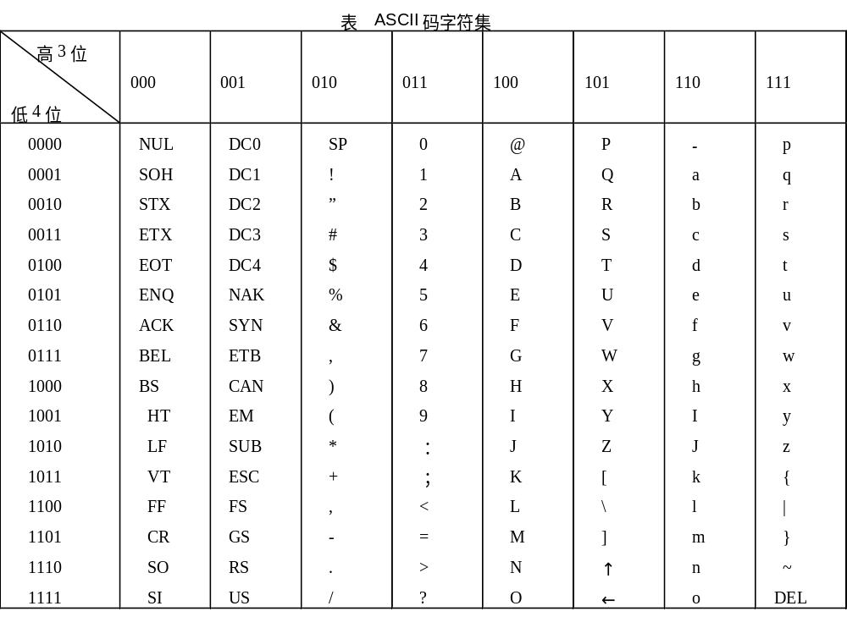

Slide 25
2.3 Representing Data---Text
Extended ASCII
To make the size of each pattern 1 byte,the ASCII bit pattern are augmented with an extra 0 at the left.(00000000 to 01111111)
EBCDIC---8 bits
Unicode---16 bits
ISO—International Organization for Standardization

Slide 26
2.3 Representing Data---Numbers
Numbers are represented using binary system. But not ASCII code.
In chapter 3.

Slide 27
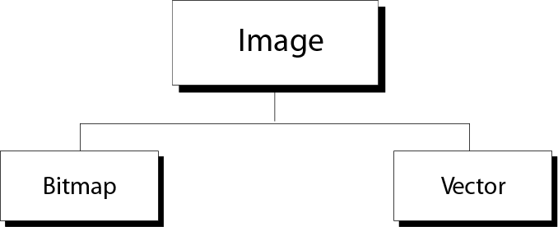
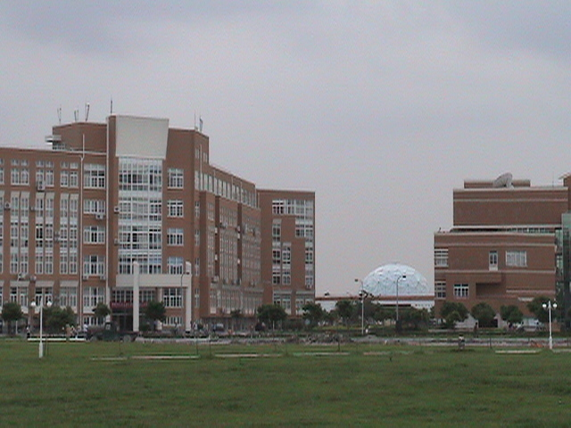
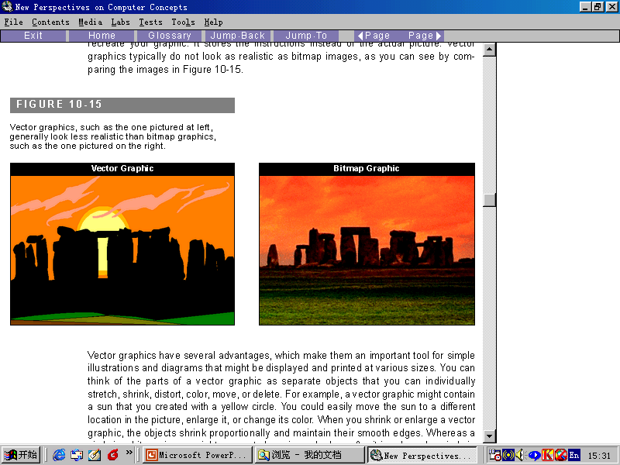
2.3 Representing Data---Images
Image representation methods
Figure 2-6

Slide 28
2.3 Representing Data---Images
Bitmap Graphic:
An image is divided into a matrix of pixels(像素), where each pixel is a small dot. The size of the pixel depends on what is called the resolution(分辩率).

Slide 29
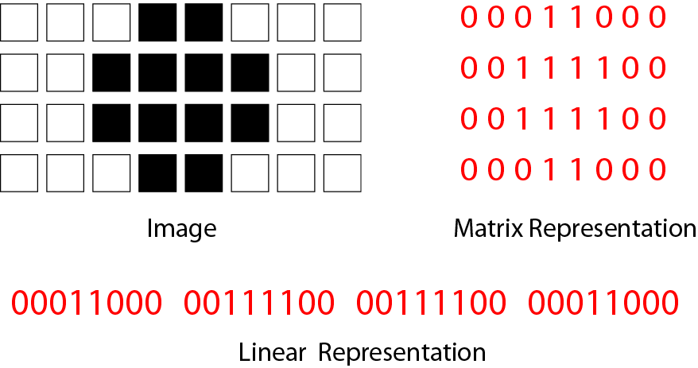
Figure 2-7(1)
Bitmap graphic method of a
black-and-white image

Slide 30
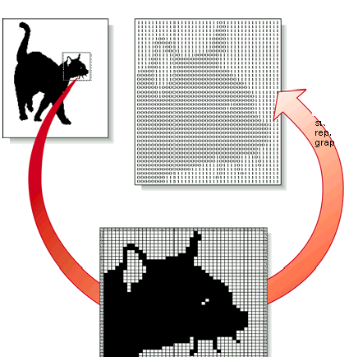
Figure 2-7(2)
Bitmap graphic method of a
black-and-white image

Slide 31
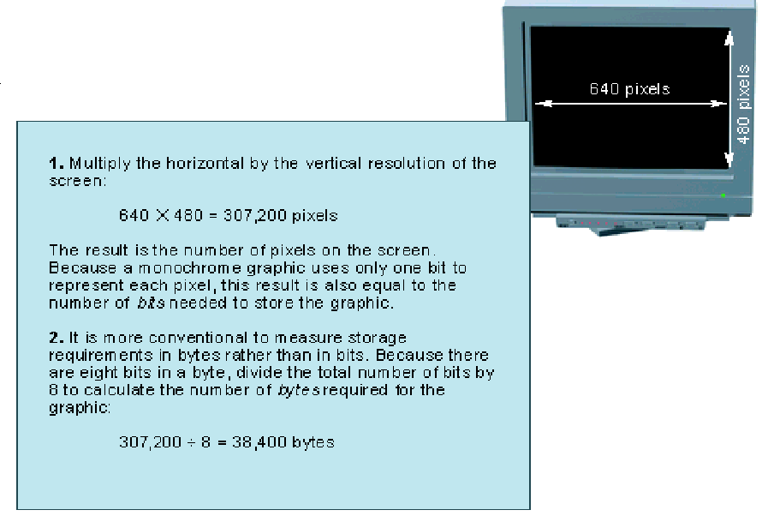

Slide 32
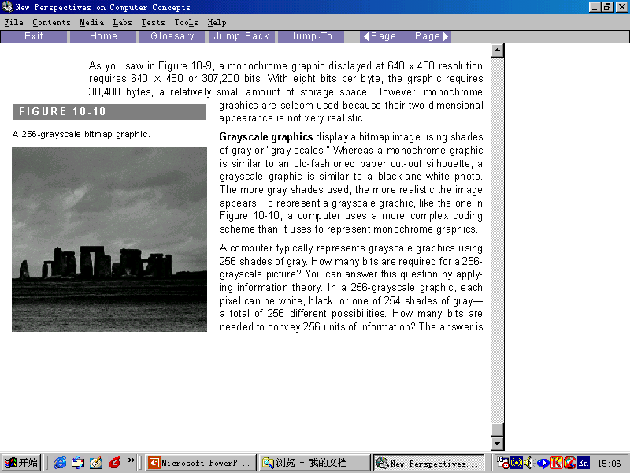
Grayscale graphics : In a 256-grayscale graphic,each pixel can be white, black, or one of 254 shades of gray- a total of 256 different possibilities.

Slide 33
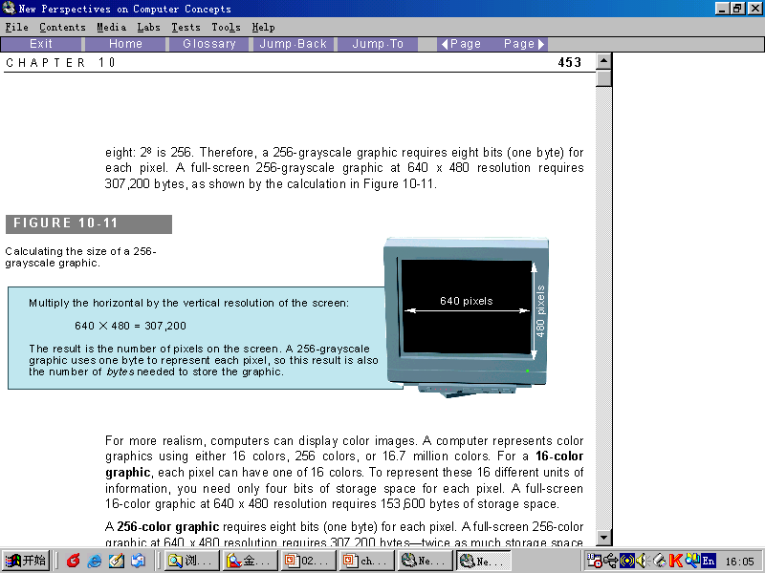
256-grayscale graphic
640×480=307200 pixel
640×480 × 8=307200 ×8 bits
640×480 ×8/8=307200 bytes

Slide 34
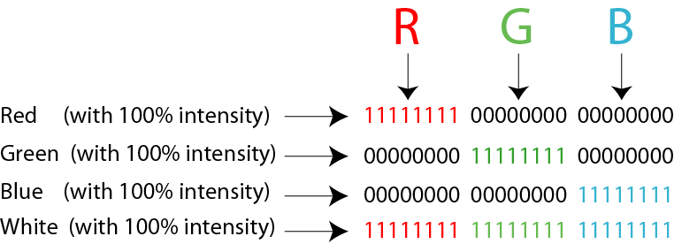
Figure 2-8
Representation of color pixels

Slide 35
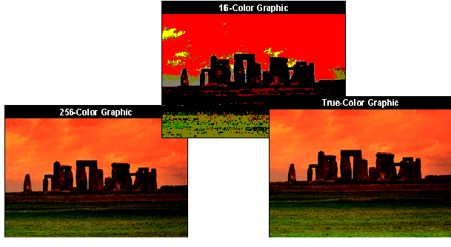
Representation of color pixels
The storage space for a 16 color、a 256 color 、or a true-color(24-bit) graphics:
16 color: 640 × 480×4/8
256 color: 640 × 480×8/8
True-color: 640 × 480×24/8

Slide 36
Vector graphics
The vector graphics method, however, does not store the bit pattern.
An image is decomposed into a combination of curves and lines.Each curve or line is represented by a mathematic formula.
The combination of these formulas is stored in a computer.

Slide 37
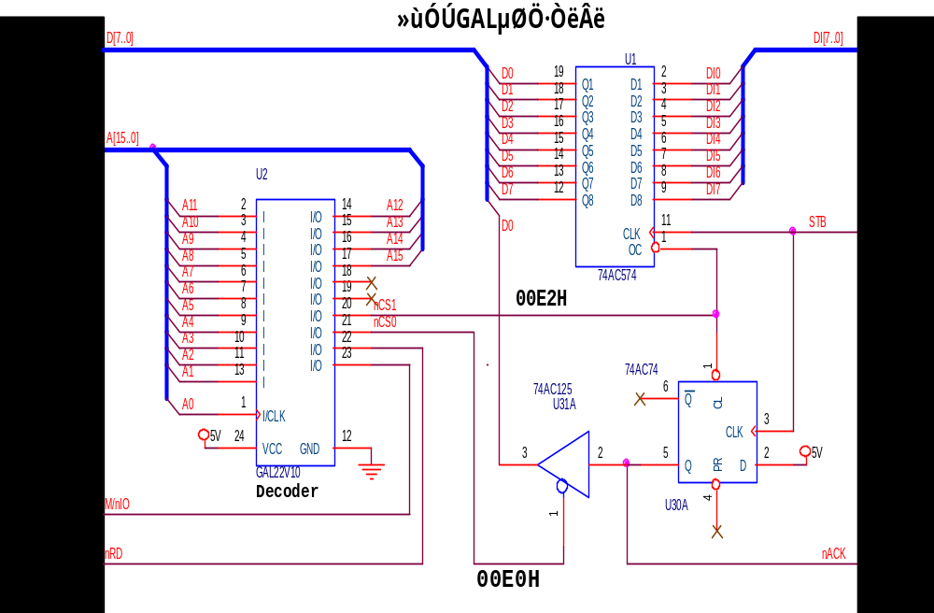
Vector graphics

Slide 38
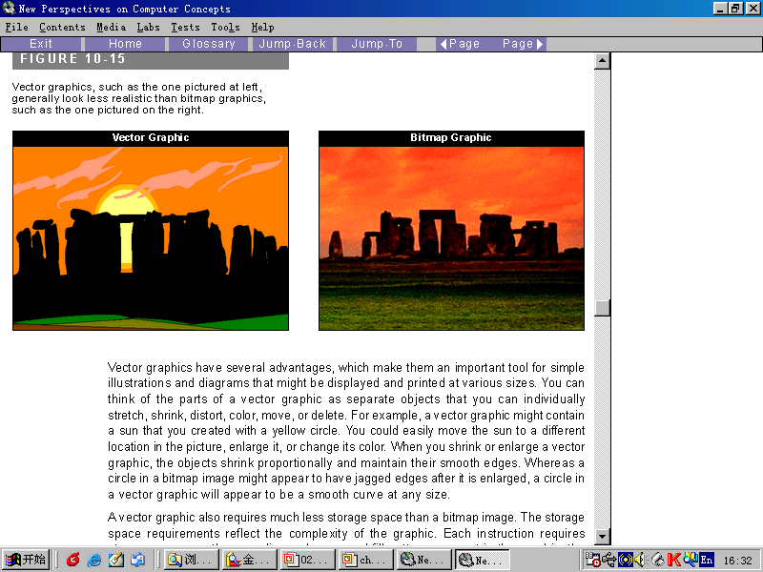

Slide 39
2.3 Representing Data---Audio
Sampling---The analog signal is sampled. Sampling means measuring the value of the signal at equal intervals.
Quantization---The samples are quantized. Quantizating means assigning a value(from a set) to a sample.
Coding---The quantized values are changed to binary pattern.
Store---The binary patterns are stored.

Slide 40
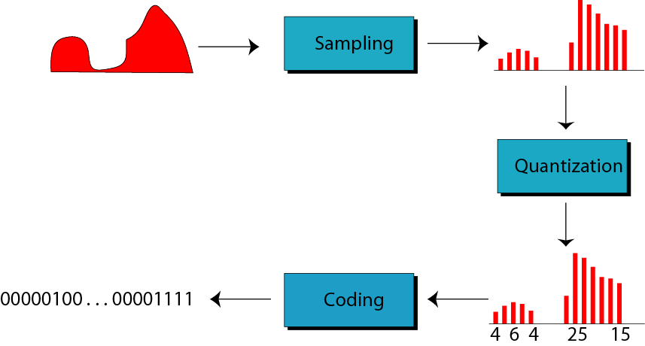
Figure 2-9
Audio representation

Slide 41
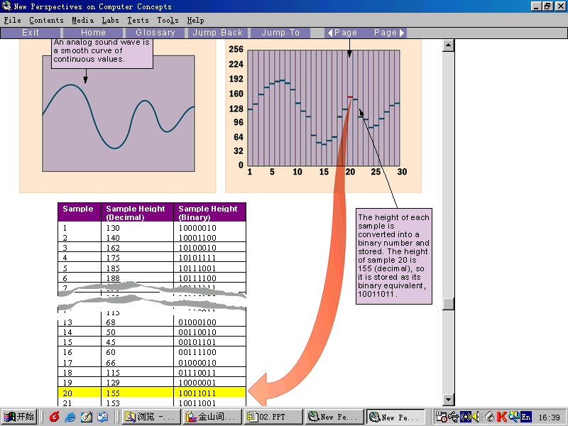

Slide 42
2.3 Representing Data---Video
Video is a representation of images(called frames).
See chapter 15.

Slide 43
2.4 Hexadecimal Notation
Hexadecimal Notation （十六进（制）记数法） is based on 16.
16 symbols(hexadecimal digit):
0,1,2,3,4,5,6,7,8,9,A,B,C,D,E,F
each symbols represents 4 bits.
A 4-bit pattern can be represented by a hexadecimal digit.

Slide 44
Hexadecimal digit
Bit Pattern | Hexadecimal digit | Bit Pattern | Hexdecimal digit
0000 | 0 | 1000 | 8
0001 | 1 | 1001 | 9
0010 | 2 | 1010 | A
0011 | 3 | 1011 | B
0100 | 4 | 1100 | C
0101 | 5 | 1101 | D
0110 | 6 | 1110 | E
0111 | 7 | 1111 | F

Slide 45
Example
Example1: Show the hexadecimal equivalent of the bit pattern
110011100010
Solution: xCE2
Example 2: Show the hexdecimal equivalent of the bit pattern
0011100010.
Solution: x0E2
Example 3: What’s the bit pattern for x24C?
Solution: 001001001100

Slide 46
2.5 Octal Notation
Octal Notation is based on 8.
8 symbols(octal digit):
0,1,2,3,4,5,6,7
each symbols represents 3 bits.
A 3-bit pattern can be represented by a octal digit.

Slide 47
Octal digit
Bit Pattern | Octal digit | Bit Pattern | Octal digit
000 | 0 | 100 | 4
001 | 1 | 101 | 5
010 | 2 | 110 | 6
011 | 3 | 111 | 7

